Slide 1
TEST 1

Slide 2
major / ˈmeɪdʒə / adjective [ usually before noun ] very large or important, when compared to other things or people of a similar kind OPP minor major role/part/factor etc
- Britain played a major role in the negotiations.
- a major road

Slide 3
valid / ˈvæləd, ˈvælɪd / adjective a valid ticket, document, or agreement is legally or officially acceptable OPP invalid :
- a valid credit card
- Your return ticket is valid for three months.

Slide 4
expiry date the date after which something is not safe to eat or can no longer be used SYN expiration date American English :
- Check the expiry date on your passport.

Slide 5
insure / ɪnˈʃʊə / verb to buy insurance so that you will receive money if something bad happens to you, your family, your possessions etc : insure something for £1,000/$2,000 etc
- You should insure the painting for at least £100,000.

Slide 6
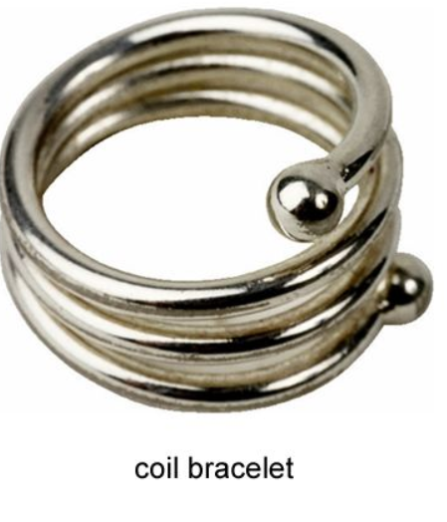
bracelet / ˈbreɪslət, ˈbreɪslɪt / noun a band or chain that you wear around your wrist or arm as a decoration
- a gold bracelet

Slide 7
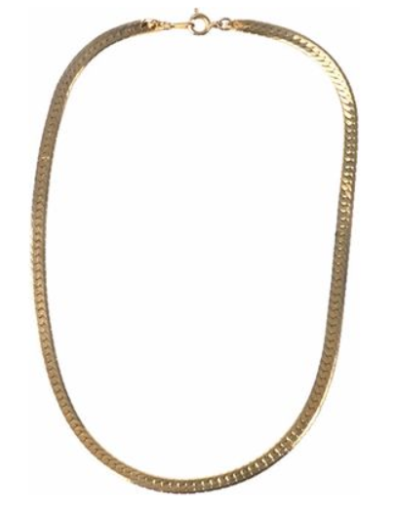
necklace / ˈnek-ləs, ˈnek-lɪs / noun a string of jewels, beads etc or a thin gold or silver chain to wear around the neck pearl/gold/diamond etc necklace
- She was wearing a coral necklace.

Slide 8
postage / ˈpəʊstɪdʒ / noun the money charged for sending a letter, package etc by post :
- How much is the postage for a postcard?

Slide 9
count on/upon somebody/something phrasal verb
1 to depend on someone or something, especially in a difficult situation :
- You can count on me.
2 to expect something :
- We didn’t count on so many people being on vacation.

Slide 10
transit / ˈtrænsət, ˈtrænsɪt / noun the process of moving goods or people from one place to another :
- baggage that is lost or damaged in transit (= while it is being moved ) transit by air or sea

Slide 11
envy / ˈenvi / verb to wish that you had someone else’s possessions, abilities etc :
- I really envy you and Ian, you seem so happy together. envy somebody something
- He envied Rosalind her youth and strength.

Slide 12
ˈmini-bar / ˈmɪnibɑː / noun a small fridge in a hotel bedroom, in which drinks are kept

Slide 13
soda / ˈsəʊdə / noun ( also soda water ) water that contains bubbles and is often added to alcoholic drinks :
- a Scotch and soda

Slide 14
biscuit / ˈbɪskət, ˈbɪskɪt / noun British English a small thin dry cake that is usually sweet and made for one person to eat SYN cookie American English :
- a packet of chocolate biscuits cheese and biscuits

Slide 15
course / kɔːs / noun one of the separate parts of a meal three-course/five-course etc meal
- The ticket includes entry and a four-course meal. first/second/main etc course
- We had fish for the main course.

Slide 16
coupon / ˈkuːpɒn / noun a small piece of printed paper that gives you the right to pay less for something or get something free :
- The coupon entitles you to ten cents off your next purchase.

Slide 17
show up phrasal verb informal to arrive, especially at the place where someone is waiting for you SYN turn up :
- Seth showed up, apologising for being late.
- We had 200 people show up for our seminar.

Slide 18
ˈsavings account noun a bank account in which you keep money that you want to save for a period of time, and which pays you interest on the money you have in it → checking account , current account

Slide 19
initial / ɪˈnɪʃəl / adjective happening at the beginning SYN first :
- an initial investment of £5000 initial stage/phase/period the initial stages of the disease

Slide 20
deposit / dɪˈpɒzət, dɪˈpɒzɪt / noun an amount of money that is paid into a bank account OPP withdrawal deposit into
- I’d like to make a deposit (= pay some money ) into my savings account.

Slide 21
slip noun a small or narrow piece of paper :
- a slip of paper
- an order slip
- a payslip

Slide 22
explore / ɪkˈsplɔː / verb to travel around an area in order to find out about it :
- Venice is a wonderful city to explore.

Slide 23
counter / ˈkaʊntə / noun the place where you pay or are served in a shop, bank, restaurant etc :
- He wondered if the girl behind the counter recognised him.

Slide 24
sell out phrasal verb
1 if a shop sells out of something, it has no more of that particular thing left to sell be/have sold out
- Sorry, we’re sold out. sell out of
- We’ve completely sold out of those shirts in your size, sir.
2 if products, tickets for an event etc sell out, they are all sold and there are none left :
- Wow! Those cakes sold out fast. be/have sold out
- Tonight’s performance is completely sold out.

Slide 25
gum = ˈchewing gum noun a type of sweet that you chew for a long time but do not swallow

Slide 26
cater / ˈkeɪtə / verb to provide and serve food and drinks at a party, meeting etc, usually as a business cater for
- This is the biggest event we’ve ever catered for.
- Joan has catered functions for up to 200 people.

Slide 27
banquet / ˈbæŋkwət, ˈbæŋkwɪt / noun a formal dinner for many people on an important occasion :
- a state banquet (= one attended by heads of government and other important people

Slide 28
fried / fraɪd / adjective having been cooked in hot oil :
- fried chicken

Slide 29
decent / ˈdiːsənt / adjective of a good enough standard or quality :
- a decent salary
- Don’t you have a decent jacket?

Slide 30
Mintz
Acme Company
Royalton Hotel

Slide 31
THANK YOU

